Slide 1
SMARTIE
A Smarter Way of Building Intelligent AI Bots
https://smartie-ai.web.app/

Slide 2
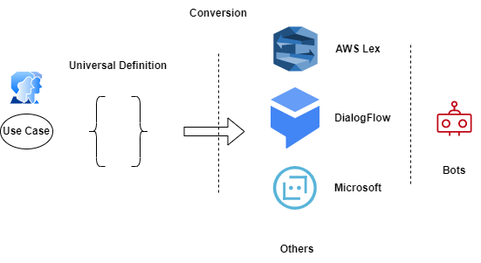
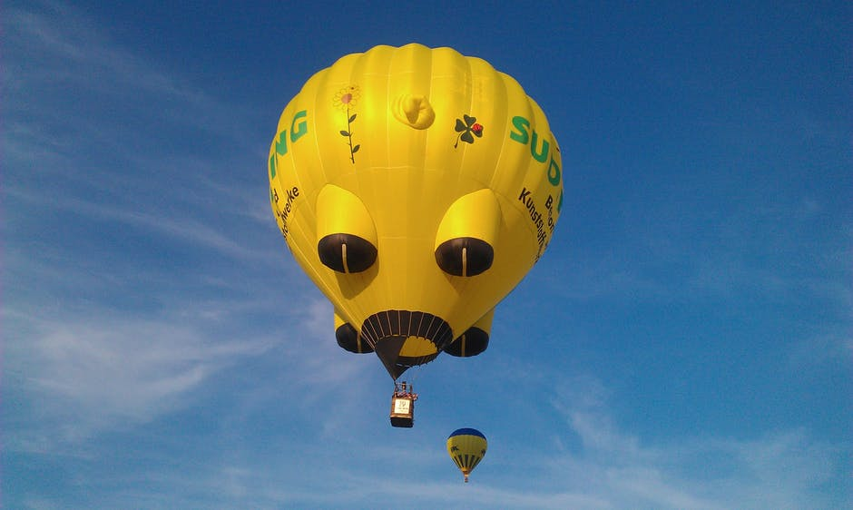
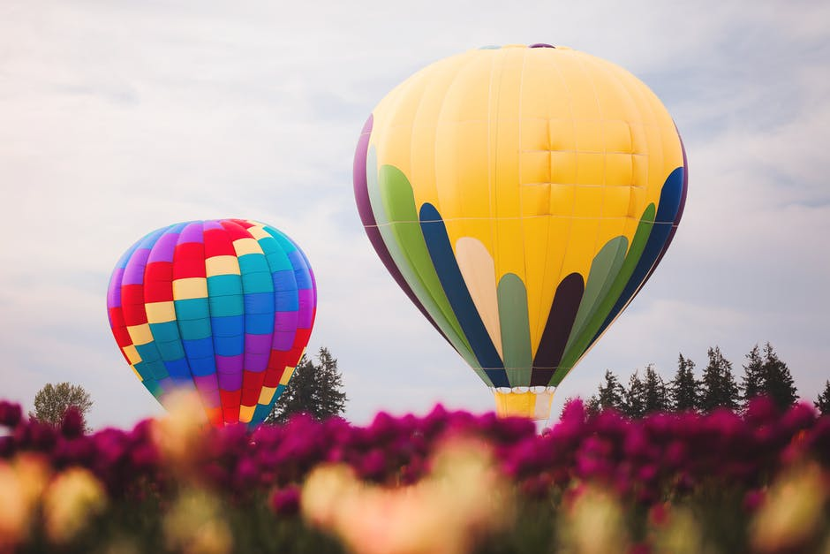
Universal Layer
Universal Bot definition is most innovative of storing a bot definition. Conversion Api can convert this universal bot definition to any of the bot services on a single click.
https://smartie-ai.web.app/

Slide 3
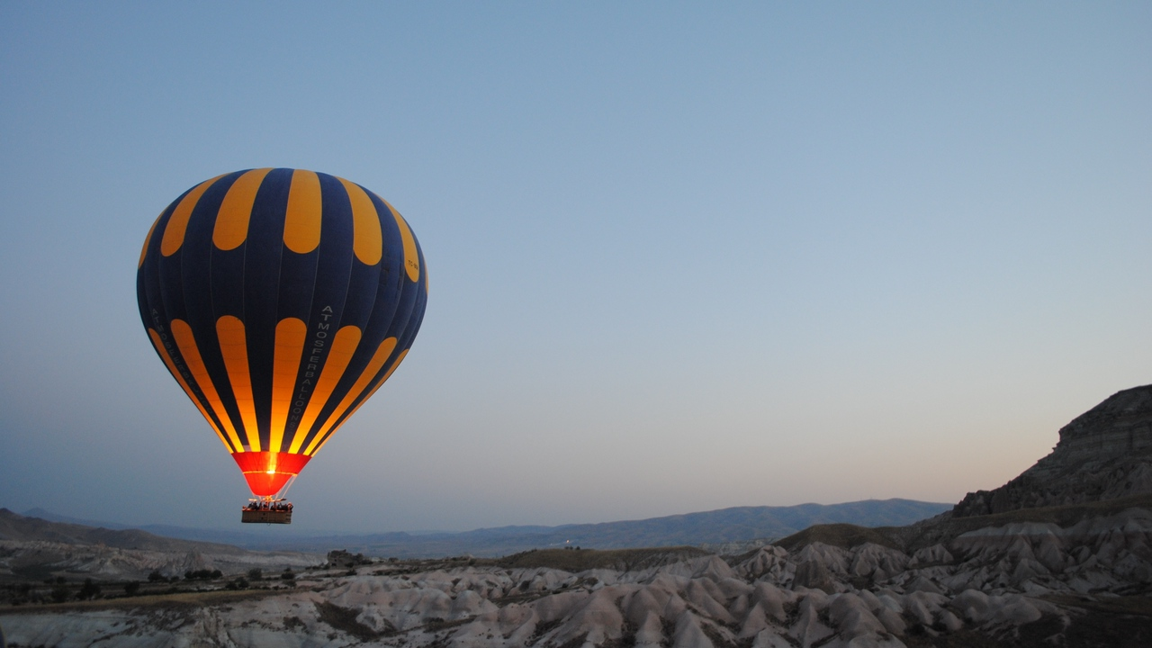

Our Motivation.
Intelligent Bots with AI
Components
Strong & Advance
Language Model AI Bots
ML - Recommendation Engine
RL - Enhance User experience and interactions
FAQ - Easily Built FAQ engine for answering FAQs
NLP - Advance NLP features.
Bert - Summerization
Bert - Wiki bot
Powered by Advance AI/NLP
We use most advance and reliable azure services for building AI assistant.

Slide 4
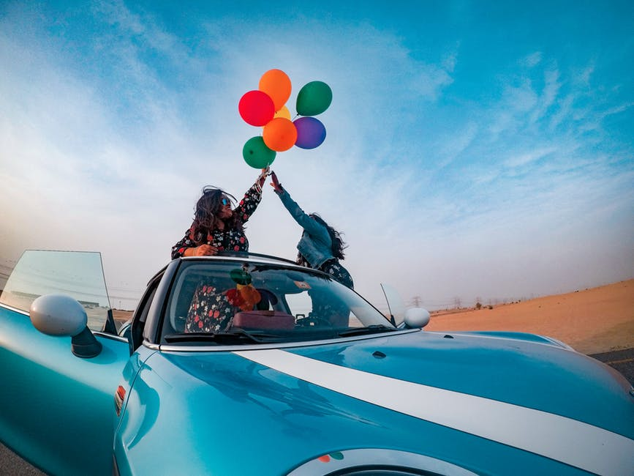
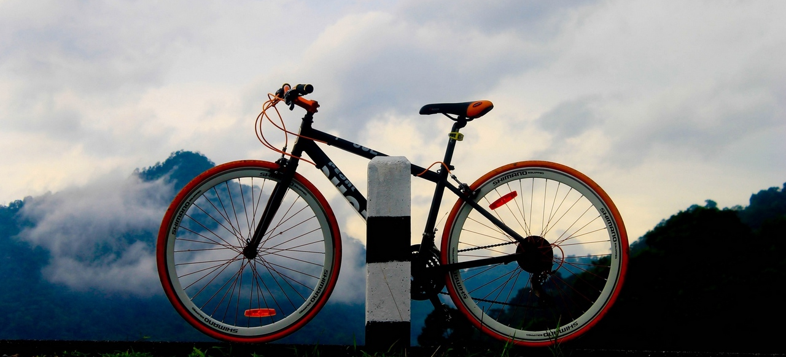

ML - Machine Learning
Affordable AI
metaverse
Recommendation Engine
Configurable Engine
Low Shot Learning
Capable of recommending best products to user
Easily configure so the our model can recommend and learn about new products
With out Low Shot learning our ML models works efficiently with low data.
High Performance
Innovatife & Creative
Give Smart Solution

Slide 5
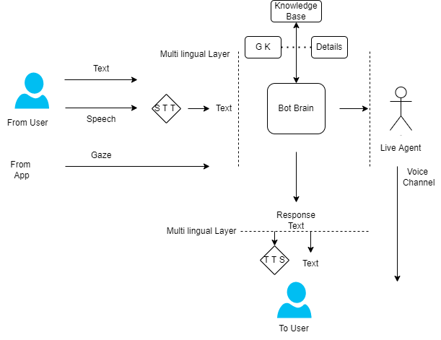
ARIA Naration AI Bot
ARIA Bot
Most advance AI Voice / Chat Bot powered by Microsoft Azure
Note: Actual architecture may slightly change w.r.t different azure services and capabilities.

Slide 6
UseCases.
ARIA - Classrooms
Swuiggy Bot
Youtube Content Creator
Highly innovative
Innovatife & Improvise Banking
Health Care Innovation

Slide 7

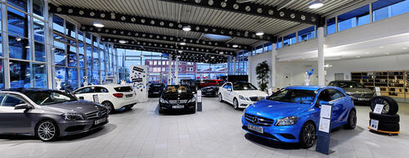





Capabilities
Students
Employees
Can learn more effectively
Can learn very fast
Guided Virtual Tours, Collaborative Tours ( ARIA together )
HR policies, Office Walkthrougs etc
Internet User
Metaverse User
Enriched Understanding
ARIA Study, ARIA Narration
Any information in internet can be consumed more effectively
Schools, Students, Personalization

Slide 8
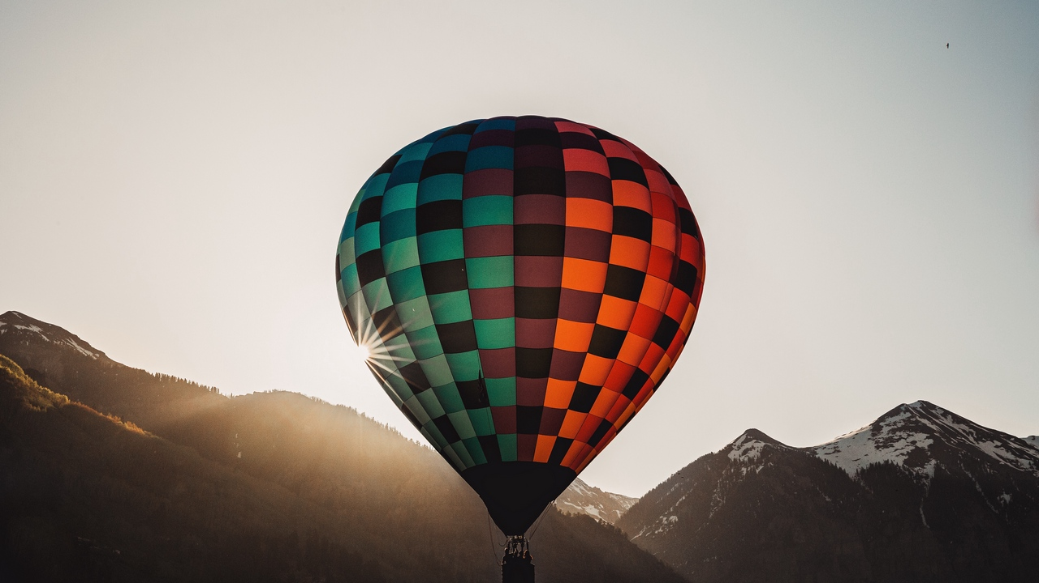
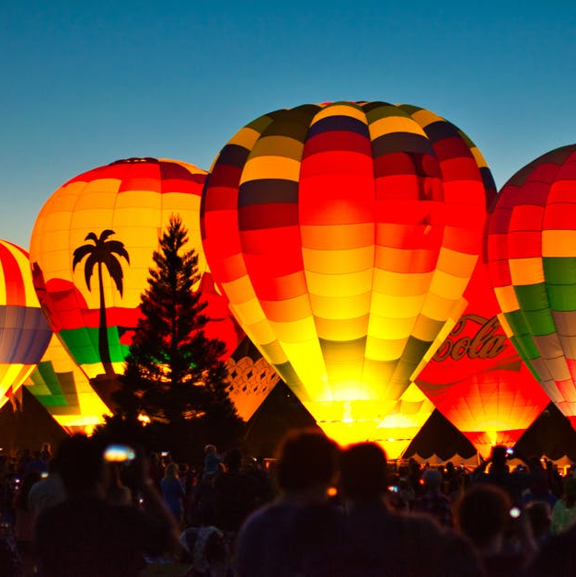




About Us.
Team
Transform Learning/business
with AI.
Passionate Team
Experienced developers
Built with open source
5
50
Customer
Validation done
Finished Project
Happy Customers

Slide 9
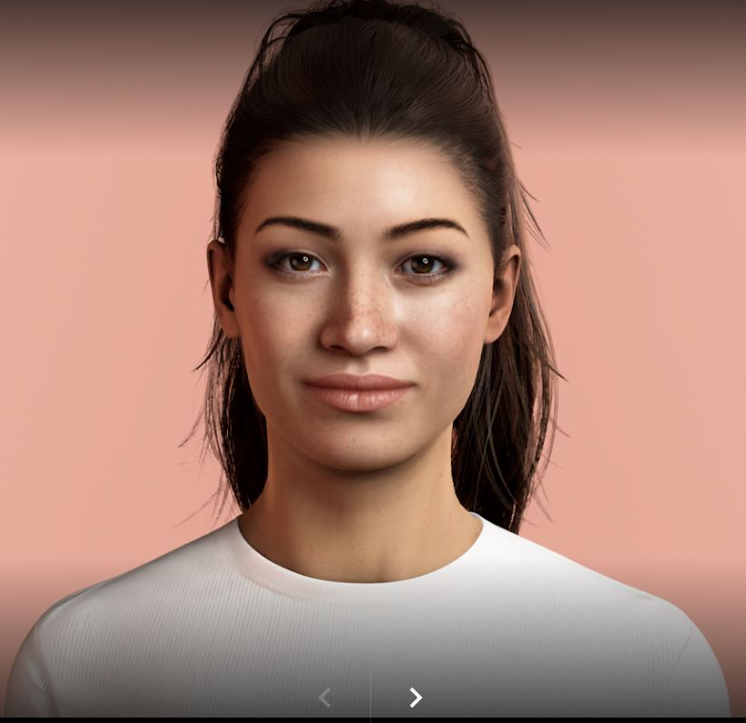
Aframe / Uneeq
Open source and Free
Used aframe open source framework for Virtual Tours
Human Digital Representations
AI Bot
Build Strong Apps
From scratch– to till now.
Azure bot services
AI bot will be built using microsoft azure services
New 2022
Azure
Holo lens

Slide 10


Vission.
VR + AI = ARIA
Passion meets people
Beautiful and immersive assisted future reality
Virtual Reality apps are eagerly waited services for many business to acquire and utilize
Virtual Tours
Most affordable way of generating 360 images
AI Bot
Brainstorming
Evolve the solution
Brainstorming
Most powerful and multilingual for the world.
We strived to make sure the products are built from scratch
With power of Azure services, AI Assitant got much powerful
Evolve the solution to world

Slide 11
Mission.
Affordable AI
To bring business to next generation of AI and VR.
metaverse
Affordable
Reliable
Immersive VR
Most affordable Learning
Most reliable
AI assitant makes much more effective
High Performance
Innovatife & Creative
Give Smart Solution

Slide 12
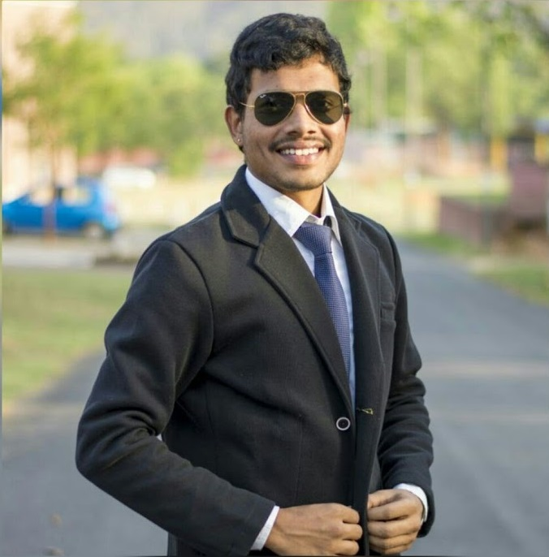




Super Team.
Modern
Team
Yeshwanth Sai
Kiran Kumar
Founder and developer
Developing Skills
90%
Developing skills
90%

Slide 13
About ME.
Strong leadership
Yeshwanth Sai
Founder and Developer
Modern
“
Always deliver more than expected.
”
Marketing
80%
Selling
95%
Team Building
90%

Slide 14
World wide languages. (Scale at Ease)
Russia
Europa
Modern
Engish
Asia
Africa
Australia
We can support 119 languages world wide

Slide 15
Thank You.
Virtual Reality meets Artificial Intelligence
ARIA

